Slide 1

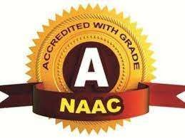
CMR TECHNICAL CAMPUS
UGC AUTONOMOUS
Accredited by NBA & NAAC with A Grade
Approved by AICTE, New Delhi and Affiliated to JNTU, Hyderabad
Department of Information Technology
Review-1
Industrial Oriented Mini Project
on
IMAGE BASED PADDY DISEASE RECOGNITION USING RESNET101 DEEP NETWORK
Under the Guidance of Mr.MD.Sajid Pasha
(Assistant Professor)
PRESENTED BY:-
227R1A12B9-P.Vaishnavi
227R1A12B2-M.Anusha
237R5A1213-R.Rakshith
227R1A1299-K.Rajesh

Slide 2
CONTENTS
Abstract
Introduction
Existing System
Proposed System
Software and Hardware Requirements
System Architecture
Modules
Algorithms
UML Diagrams
Conclusion

Slide 3
ABSTRACT
A variety of diseases attack rice, one of India's most widely planted crops, at various phases in the growing process. It is exceedingly difficult for farmers with poor understanding to identify these diseases manually. Our deep learning model was created using Transfer Learning on a dataset.VGG-16 is utilized to train and assess the proposed CNN architecture, which is based on rice field and internet datasets.

Slide 4
INTRODUCTION
In India and around the world, rice is the primary source of nutrition.However, various diseases such as bacterial leaf blight, rice blast, and brown spot significantly affect paddy yields, leading to severe economic losses for farmers.With advancements in artificial intelligence (AI) and deep learning, Convolutional Neural Networks (CNNs) have emerged as a powerful tool for image-based disease classification. Transfer Learning is a powerful technique, allowing to leverage pre-trained models on large datasets and adapt them to new datasets to classify rice leaf diseases accurately. CNNs can automatically learn spatial features from images, making them well-suited for detecting and classifying paddy diseases based on leaf symptoms.

Slide 5
EXISTING SYSTEM
In the past, the only way to identify a disease was to manually examine the leaf.
The illness was discovered using a combination of visual inspection of plant leaves and consulting a reference book.
As science and technology progress, new methods for accurately diagnosing these diseases emerge.
Some existing systems incorporate with machine learning models like ANN,Support Vector Machines (SVM).

Slide 6
DISADVANTAGES OF EXISTING SYSTEM :
It is impossible to analyse every leaf manually.
The Farmers may require expertise knowledge about Diseases.
Low Accuracy.
A lengthy time investment.

Slide 7
PROPOSED SYSTEM
A VGG16 transfer learning neural network is used in this project to train a dataset of rice diseases, and the trained model may be used to predict disease from new photos and improves prediction accuracy.This proposed CNN-based system significantly enhances paddy disease recognition, empowering farmers with advanced AI-driven solutions for disease diagnosis and improved crop health management.

Slide 8
ADVANTAGES OF PROPOSED SYSTEM:
High accuracy
It is possible to analyse every leaf
Works on Large Datasets
Time investment is low

Slide 9

SOFTWARE& HARDWARE REQUIREMENTS:
◆ SOFTWARE REQUIRMENTS :
Front end Technologies : HTML,CSS
Back end Technologies : Python
Framework : Django
◆ HARDWARE REQUIRMENTS :
Processor : intel i5
Hard Disk : 1TB
RAM : 4GB

Slide 10
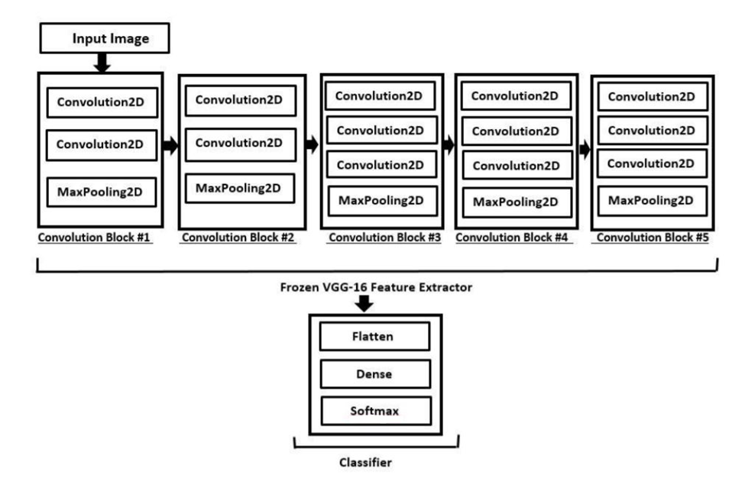
SYSTEM ARCHITECTURE

Slide 11
MODULES
ADMIN MODULE
Uploads and manages the training dataset, monitors the model, and ensures that it is performing optimally. The admin manages system updates and re-trainings when necessary.
USER MODULE
Uploads images of crops for disease identification. The system uses the trained VGG-16 model to diagnose diseases and provide actionable insights. Users can interact with the system to receive recommendations and alerts.

Slide 12
ALGORITHMS
CONVOLUTIONAL NEURAL NETWORKS
In this project, we used a Convolutional Neural Network, specifically the VGG-16 model, to recognize paddy leaf diseases. First, the input image is resized and preprocessed. It then passes through several convolutional layers, where the model automatically learns important features like spots or patterns that indicate disease.Next, we apply an activation function called ReLU, which helps the model learn complex patterns. Pooling layers are then used to reduce the image size while keeping the important information. After this, the data is passed through fully connected layers that make the final decision.

Slide 13
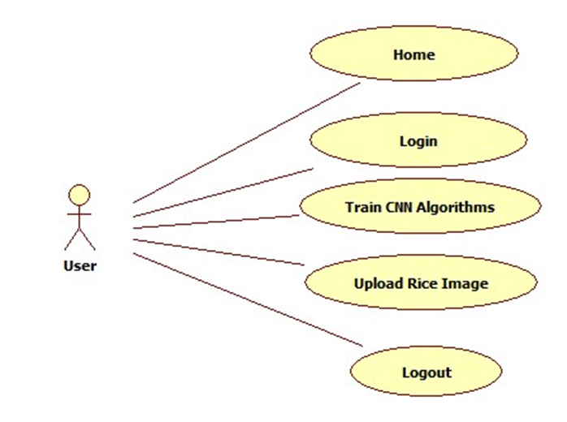
UML DIAGRAMS
1.USECASE DIAGRAM

Slide 14
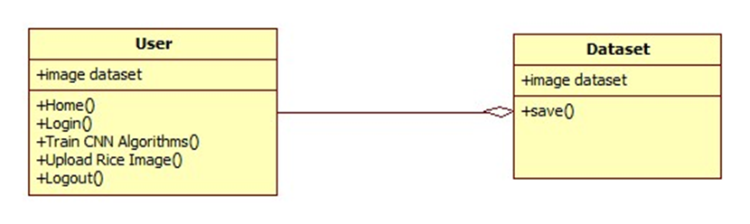
2.CLASS DIAGRAM

Slide 15
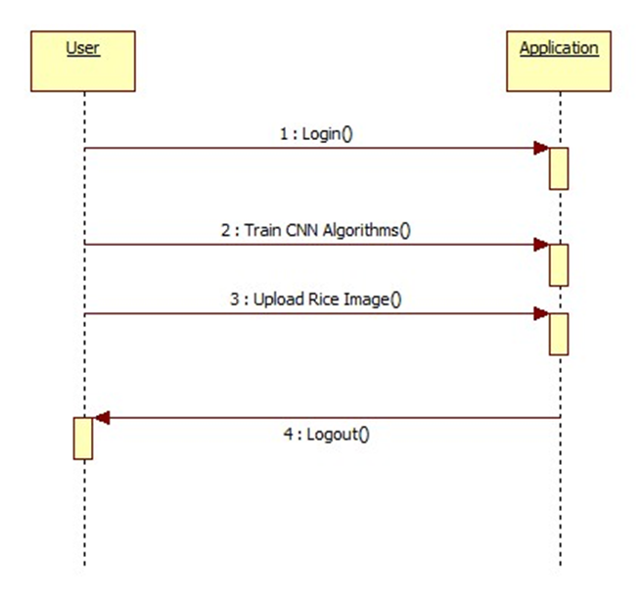
3.SEQUENCE DIAGRAM

Slide 16
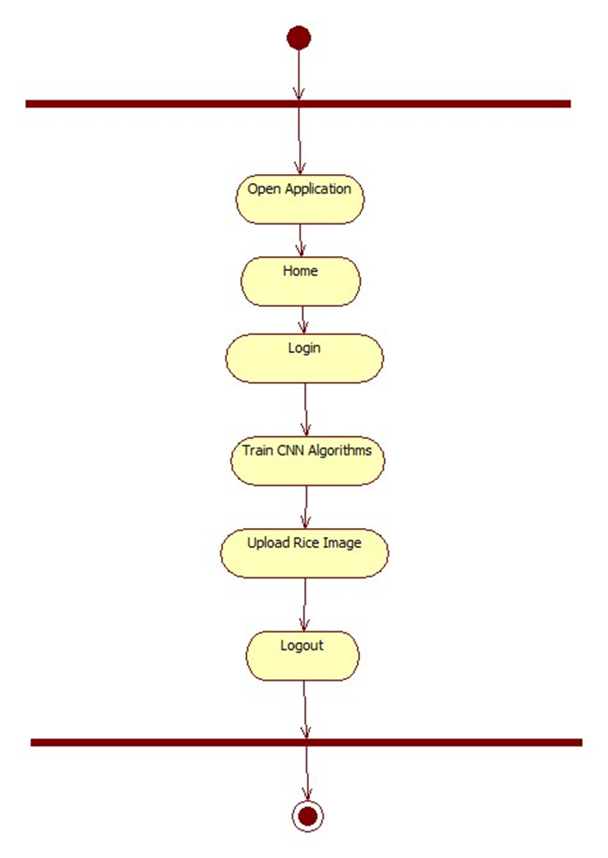
4.STATE DIAGRAM

Slide 17
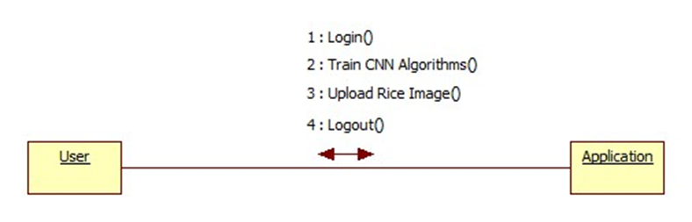
5.COLLABORATION DIAGRAM

Slide 18
CONCLUSION
By leveraging the powerful feature extraction capabilities of VGG-16, the system was able to classify various paddy diseases with high accuracy, demonstrating the potential of deep learning in agricultural applications. This model effectively detects diseases like blast, brown spot, and bacterial blight, showing deep learning’s potential in smart agriculture.This approach offers a reliable, automated solution that can assist farmers and agricultural experts in early detection and treatment of plant diseases, thereby improving crop health and yield.

Slide 19


